Slide 1

CAP444 OBJECT ORIENTED PROGRAMMING USING C++

Slide 2
Topics Covered
Principles of OOP :
classes and objects,
access specifiers,
constructors: types of constructors,
multiple constructor in a class,
destructors,
functions overloading,
friend function,
inheritance: types of inheritance

Slide 3

Class
Class is a collection of similar types of objects.
For example: Fruits is class of mango, apple , orange etc.
Fruits

Slide 4

Why class is important?

Slide 5


Slide 6
Class
Class is a collection of data members and member functions.
Example:
class Employee{
//data members
// member functions
}
Employee
employeeId employeeName
getDetails() setDetails()

Slide 7
Object
Object is an instance of a Class.
class Employee
{
int employeeId;
char employeeName[20];
public:
void getDetails(){}
void setDetails(){}
};
int main()
{
Employee e1; // e1 is a object
return 0;
}

Slide 8
In this code which option is correct?
class student
{
public:
int regno;
void getStudentDetails();
}
A: regno is data member
B. getStudentDetails() is member function
C. above both options are correct

Slide 9
access specifier
private
public
protected
By default, all members of a class are private if you don't specify an access specifier.

Slide 10
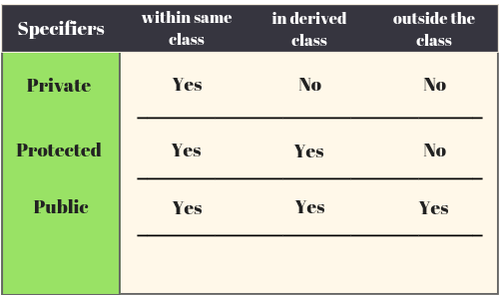

Slide 11
Select correct option
class Employee
{
int employeeId;
char employeeName[20];
public:
void getDetails(){}
void setDetails(){}
};
int main()
{
Employee e1;
e1. employeeId=1234;
cout<< e1. employeeId;
return 0;
}
1234
0
Compilation error
Run time error

Slide 12
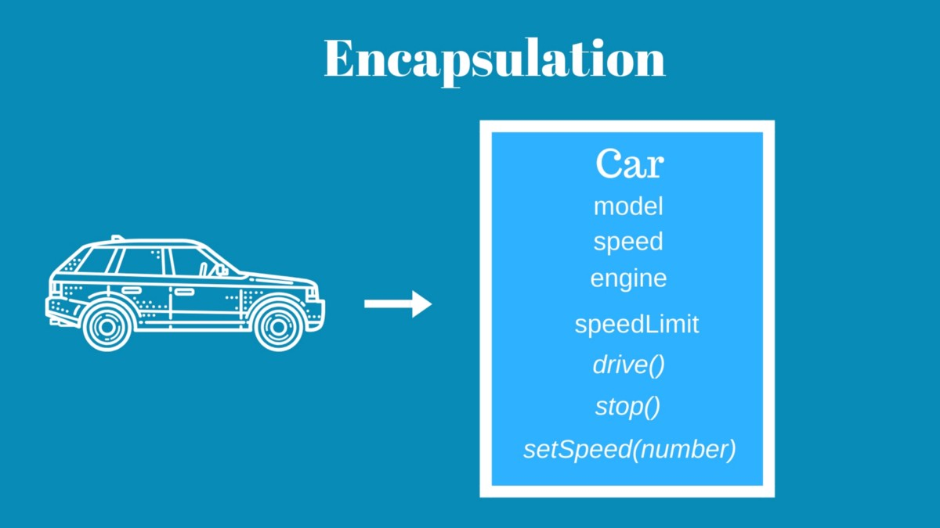
How to achieve encapsulation features in C++?

Slide 13
How to achieve encapsulation features in C++?
Define private data members in a class and
Define public set and get accessors functions which can be used to access these private data members.
Why Encapsulation?
Increased security of data

Slide 14


Constructor and destructor

Slide 15
Constructors: types of constructors
A special method which is used to initialize the object
It is automatically called when an object of a class is created.
it has the same name as the class name.
it is always public
it does not have any return type

Slide 16
Types of constructor:
Default constructor
Parameterized constructor
Copy constructor

Slide 17


Slide 18


Slide 19
Default constructor
A constructor which has no argument is known as default constructor. It is invoked at the time of creating object.
class Employee
{
public:
Employee()
{
cout<<"Default Constructor"<<endl;
}
};

Slide 20
Parameterized constructor
A constructor which has parameters is called parameterized constructor.
class Employee
{
int empId;
string empName;
public:
Employee(int id, string name)
{
empId=id;
empName=name;
}
};

Slide 21
Copy Constructor
Copy Constructor is a type of constructor which is used to create a copy of an existing object of a class.
Syntax:
class-_name(class_name & object_name)
{
}
To call this: class_name obj1(arguments);
class_name obj2 = obj1;

Slide 22
Destructor
Destructor is a special member function which destructs or deletes an object.
A destructor is called automatically when object goes out of scope.
Destructors have same name as the class preceded by a tilde (~)
Destructor should not have any parameter
There can only one destructor in a class
When a class contains a pointer to memory allocated in class, we should write a destructor to release memory

Slide 23
Which option is correct for defining the destructor?
Option1:
~mobile()
{
cout<<"destructor called"<<endl;
}
Option2:
~mobile( string str)
{
cout<<"destructor called"<<endl;
}
Option1 is correct
Option2 is correct
Both option is correct

Slide 24
Functions overloading
same function name but different parameters.
same function name with different signature
example of polymorphism(compile time)
overloaded functions should be there in same scope.

Slide 25
What will be output?
#include <iostream>
using namespace std;
void print(int i)
{
cout << i;
}
void print(double f)
{
cout << f;
}
int main()
{
print(5);
print(500.263);
return 0;
}
A) 5500.263
B) 500.2635
C) 500.263

Slide 26
Friend function
It can access all private and protected member of a class
It can be access without object of the class
It can define out side of the class scope
Rule:
Prototypes of friend function must be declare inside the class
It can be declared either in the private or the public part.

Slide 27
Example : friend function
#include <iostream>
using namespace std;
class A
{
private:
int x;
public:
A()
{
x=10;
}
private:
friend void newfriend(A &a);
};
void newfriend(A &a)
{
a.x=20;
cout<<a.x;
}
int main()
{
A a1;
newfriend(a1);
return 0;
}

Slide 28



father
mother
child

Slide 29

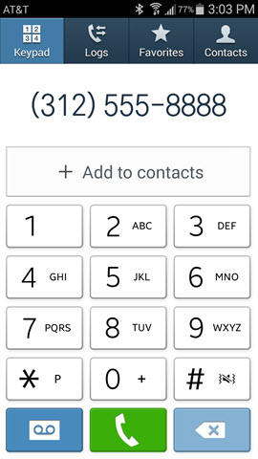

More examples of inheritance:
Contact List

Slide 30

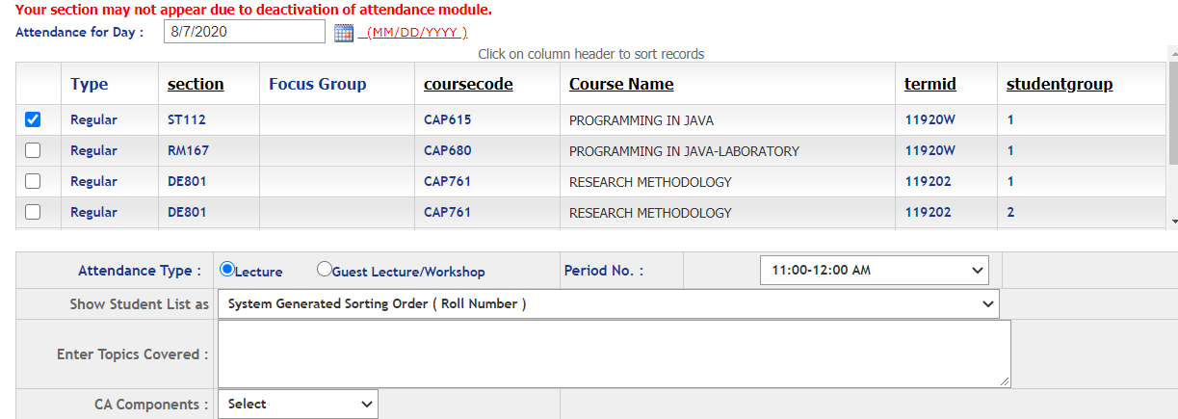
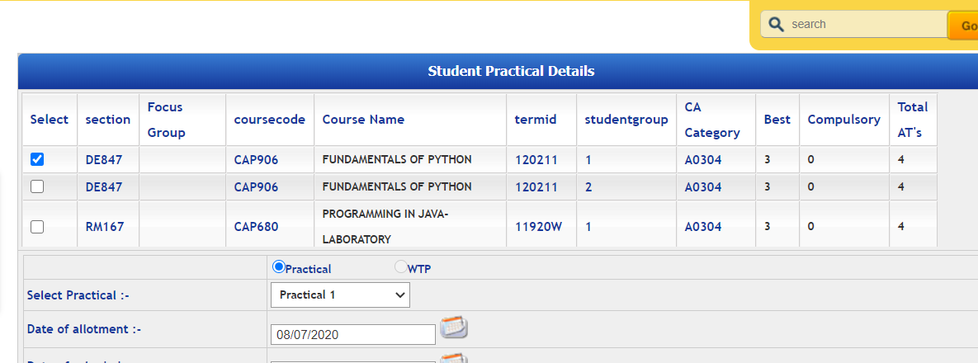
Students
More examples of inheritance:
Students in Attendance Module
Same Students in CA Module

Slide 31
Inheritance: types of inheritance
One class can hire properties from other class
Advantages: Reusability
A
A
A
B
B
B
C
C
Single
Multilevel
Multiple

Slide 32
A
A
B
C
B
C
Hierarchical Inheritance
D
Hybrid Inheritance

Slide 33
Single inheritance:
Syntax:
class derive_class_name : access_mode base_class_name
{
//body of derive_class
};

Slide 34
Multiple Inheritance:
class derive_class_name : access_mode base_class1, access_mode base_class2, ....
{
//body of derive_class
};

Slide 35
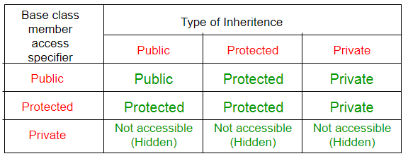
class base_class
{
//base class members (x, y)
};
class derive_class : access_Specifier base_class
{
//base class members (x, y)
//derive class members (a,b)
};

Slide 36
Any Query?

